Slide 1

Introduction to Data Science
Mini - project

Slide 2

Telco customer churn by Techie Tribe
Team members
Kavya Khatter : PES1201701136
Shreya D Nanda : PES1201700212
Gagana G S : PES1201700952

Slide 3
DATASET description
Each row represents a customer, each column contains customer’s attributes described on the column Metadata.
The raw data contains 7043 rows (customers) and 21 columns (features).
The data set includes information about:
Services that each customer has signed up for – phone, multiple lines, internet, online security, online backup, device protection, tech support, and streaming TV and movies
Customer account information – how long they’ve been a customer, contract, payment method, paperless billing, monthly charges, and total charges
Demographic info about customers – gender, age range, and if they have partners and dependents
Customers who left within the last month – the column is called Churn
The “Churn” column is our target

Slide 4
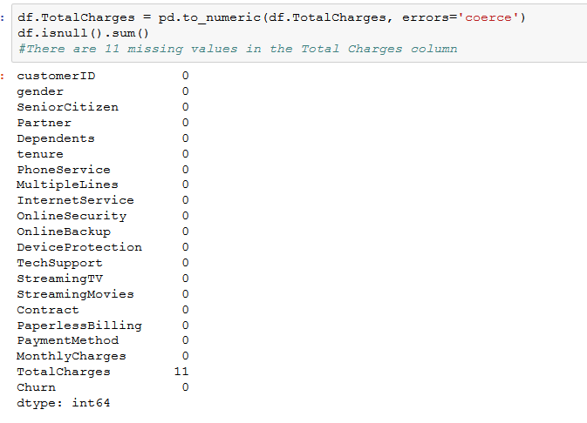
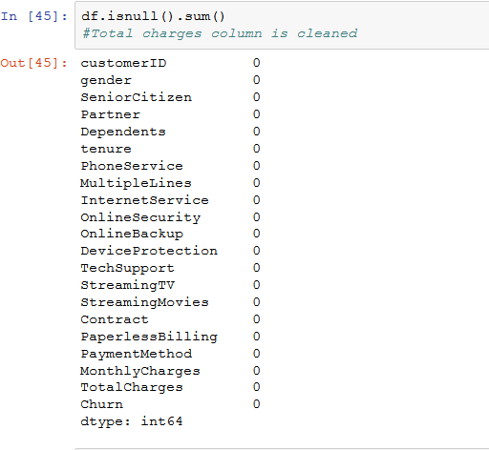
DATA CLEANING
Before data cleaning
After data cleaning

Slide 5
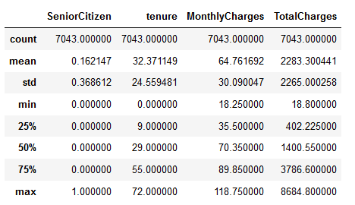
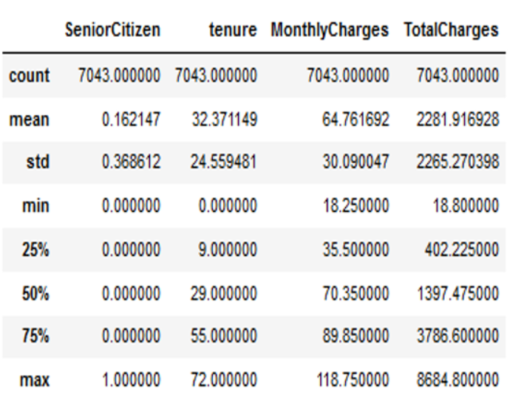
Before data cleaning
After data cleaning

Slide 6
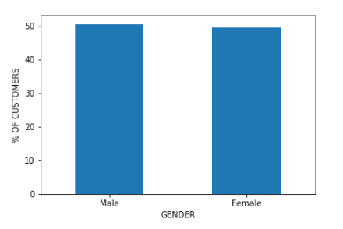
Bar graph of percentage of customers vs gender
DATA VISUALIZATION
From the plot we understand that the percentage of customers for male and females is almost same.

Slide 7
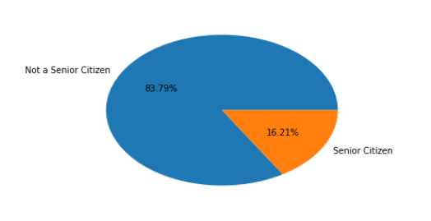
PIE CHART OF % OF SENIOR CITIZENS
From the pie chart, we can say that there are only a few percentage of customers that are senior citizens.

Slide 8
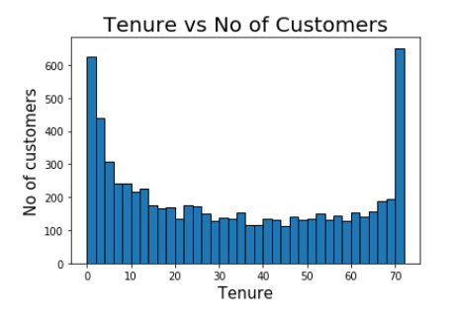
Histogram of tenure vs number of customers
From the graph we can conclude that a lot of customers have been with the telecom company for just a month, while quite a many are there for about 72 months.

Slide 9
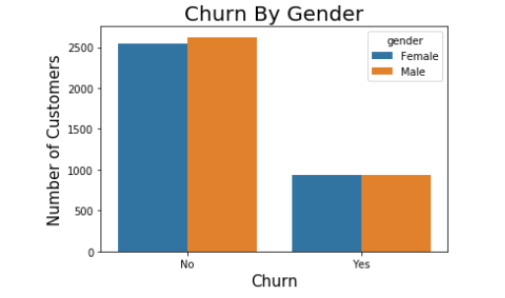
Churn By Gender
Gender does not seem to influence Churn significantly.

Slide 10
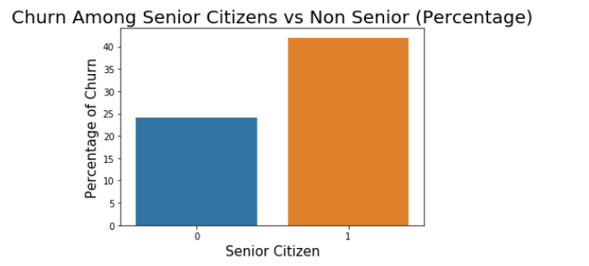
Churn among Senior Citizens vs Non Senior Citizens
Senior Citizens are churning in greater proportion, almost 42% of Senior Citizens churn compared to about 25% of non Senior Citizens.

Slide 11
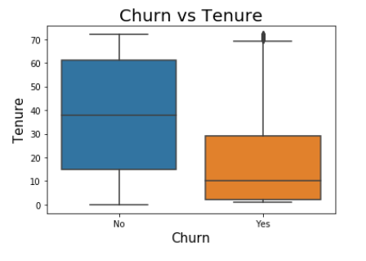
Boxplot of churn vs tenure
From the boxplot it is clearly evident that shorter is the tenure, higher is the possibility of churn.

Slide 12
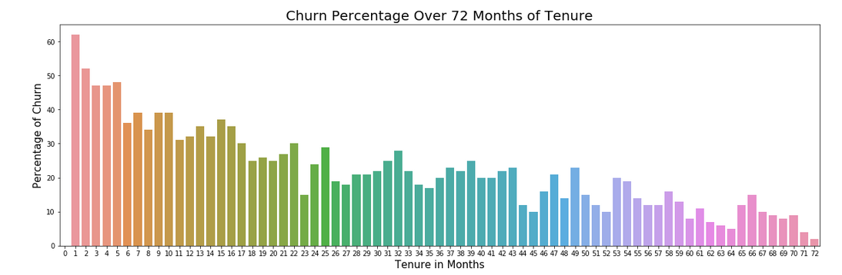
Churn Percentage over 72 Months of Tenure
Over 60% of customers who complete one month of tenure Churn.
As the length of tenure increases Churn reduces to about 3 percent at 72 months.

Slide 13
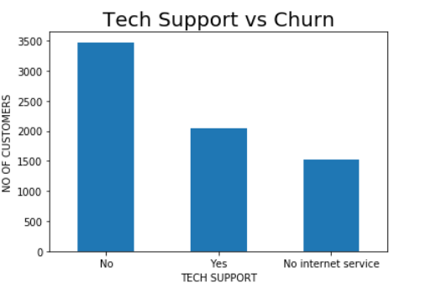
Bar graph of tech support vs churn
From the graph, we can observe that the people with tech support churn the least while those without tech support churn the most.

Slide 14
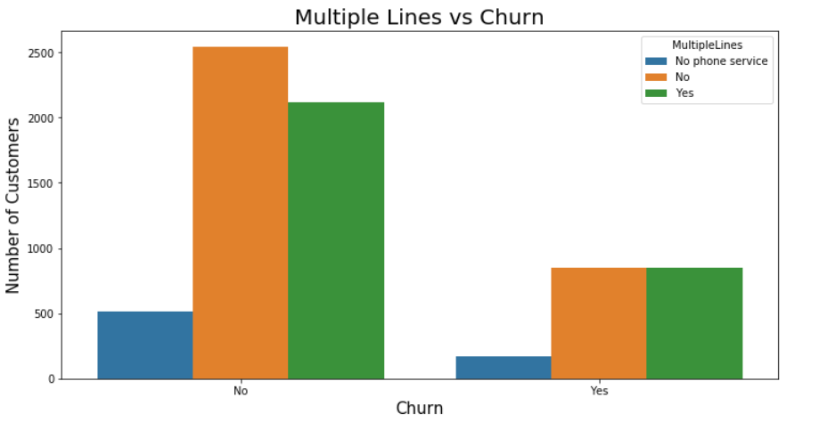
Multiple lines vs churn
From this we can observe that the customers who do not have phone service churn the MOST, while those with or without multiple lines churn almost at equal rate which implies that the multiple lines factor does not influence churn rate

Slide 15
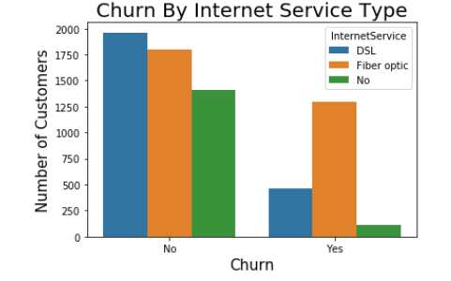
Count plot of churn vs internet service type
From the graph ,customers with Fiber Optic internet service are churning in high proportions

Slide 16
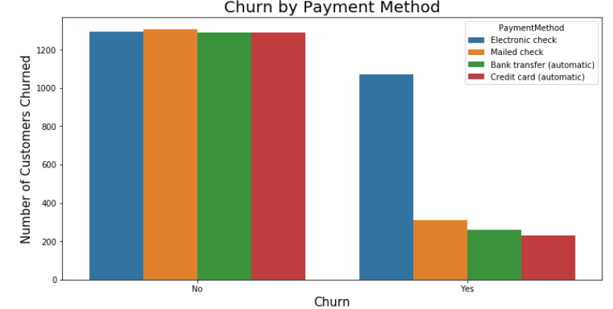
Churn by Payment Method
From the graph ,Customers with Electronic Check as mode of payment are churning in higher proportion

Slide 17
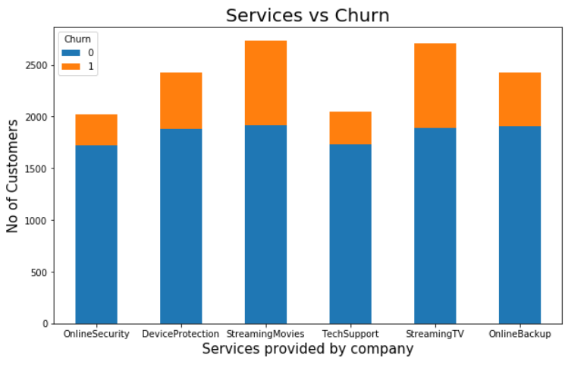
STACKED bar graph of Services vs CHURN
From the visualization we can conclude that the customers who have availed Streaming TV and Streaming Movies services from the company are churning at a greater proportion when compared to others.

Slide 18
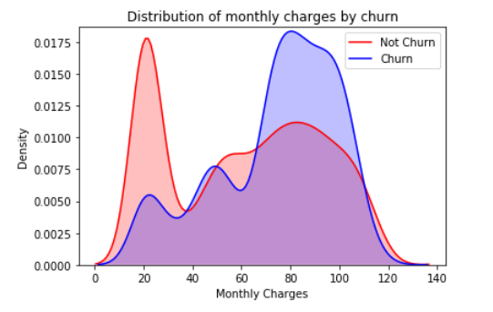
Distribution of monthly charges by churn using KDE plots
kernel density estimation(KDE) is a non-parametric way to estimate the probability density function of a random variable.
Higher % of customers churn when the monthly charges are high.

Slide 19
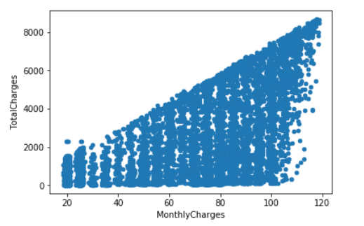
Correlation
From this graph we can conclude that total charges and monthly charges are positively correlated.

Slide 20
Hypothesis testing
Double tailed test:
Single tailed test:
Population is calculated from the dataset and a random sample is chosen from the population of size 100.
From that random sample chosen Mean is calculated and using that z score is computed.
If this value is less than the actual Z-value we reject the null hypothesis ;else we fail to reject it.

Slide 21
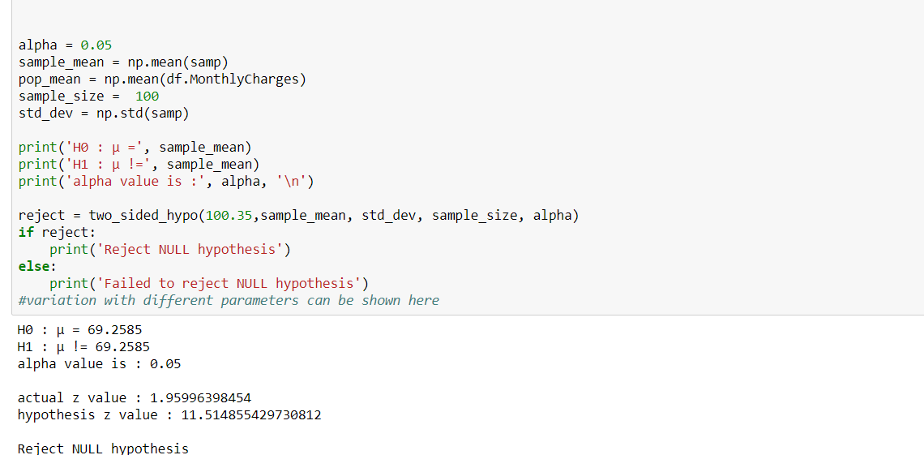
Two sided hypothesis testing on Monthly charges

Slide 22
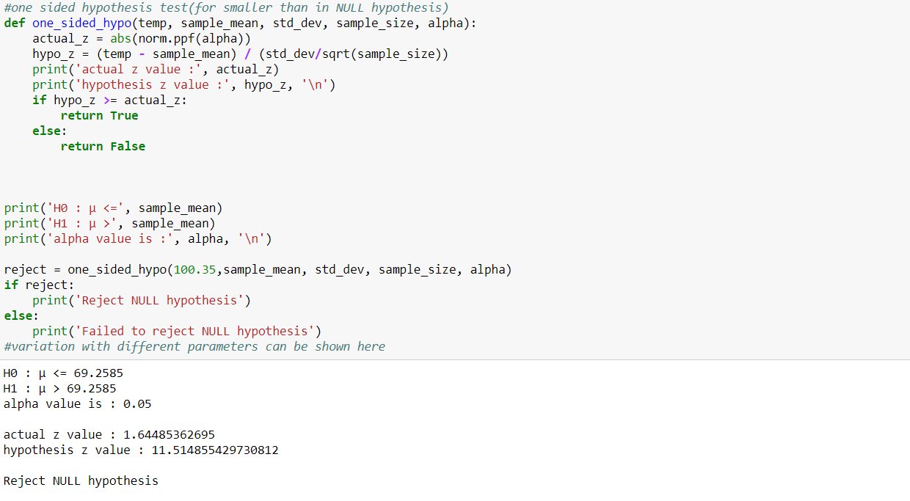
One sided hypothesis testing on Monthly charges

